Slide 1
The Battle of Neighbourhoods - CHINESE restaurant location in New York CITY

Slide 2


Introduction:
As the most famous city in the world, New York City is seen as a business hub with a variety of people. Whilst being a business district and hub, New York is in a major hunt to ensure people have the opportunity to enjoy the worldwide food.
In the meantime, Chinese food has been very popular over the western world. Hotpot, as one of the most Chinese cooking method, has already become the major attraction across North America.
Notes:
Insert a map of your country.

Slide 3
Problem:
A traditional Chinese hot pot group is looking to open a flagship restaurant in one of New York’s neighborhoods. This will be the first restaurant of that hot pot brand in the US. It does not understand the area and the availability of Chinese restaurant in each neighborhood and requires an investigation to take place in order to determine the best place for the flagship.
Decision Metrics:
Density of people for each Borough
Number of Neighbourhoods in each Borough
Number of Chinese restaurant in each Borough
Chinese restaurants in the Neighbourhood with the best density metric per gym
Cluster Chinese restaurants in Neighbourhood with the best density metric per gym
Notes:
Insert a picture of one of the geographic features of your country.

Slide 4
Data Section:
For the investigation, the following data sources will be used:
Wikipedia to obtain density of each Borough in New York city.
Source: https://en.wikipedia.org/wiki/New_York_City
Description: New York Boroughs and the density of each Borough in the New York area.
New York City data that contains list Boroughs, Neighbourhoods along with their latitude and longitude.
Source: https://cocl.us/new_york_dataset
This contains the data as mentioned above and will be used for investigating the Borough and Neighbourhoods using Foursquare API.
Chinese restaurants in each neighbourhood of New York city.
Source: Foursquare API
The API will return all known restaurants in each Borough and Neighbourhood.
Notes:
Insert a picture illustrating a season in your country.

Slide 5
Methodology:
We begin by collecting the New York city data from the following link "https://cocl.us/new_york_dataset“
We will find all venues for each neighbourhood using Foursquare API.
We will then filter out all venues with Chinese restaurant for further analysis.
Next using Foursquare API, we will find the Ratings, Tips, and Number of Likes for all the Chinese Restaurants.
We will then sort Neighbourhoods and Borough the data keeping Ratings as the constraint.
Next we will consider all the neighbourhoods with average rating greater or equal 9.0 to visualize on map.
We will join this dataset to original New York data to get longitude and latitude.
Finally, we will visualize the Neighbourhoods and Borough based on average Rating using python’s Folium library.
Notes:
Insert a picture of an animal and or plant found in your country.

Slide 6
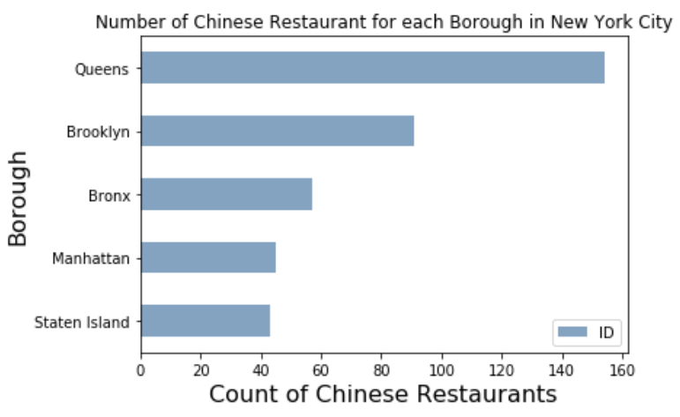
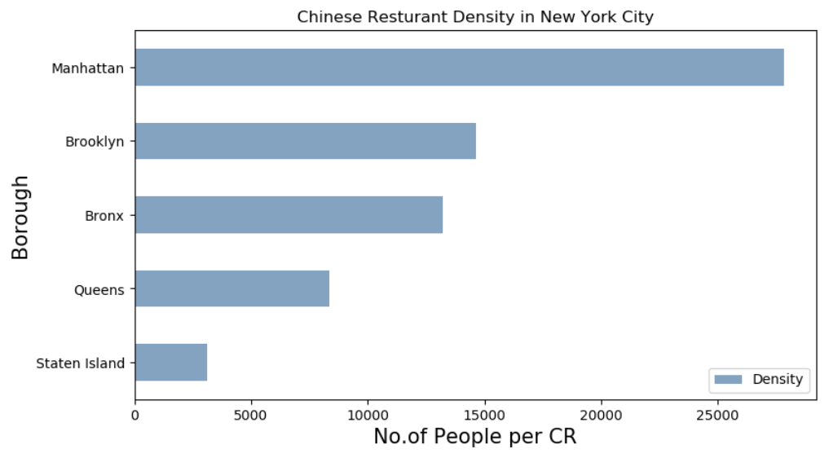
Key findings:
Manhattan has the best population density per Chinese restaurants allowing for best chance of attracting people.
Notes:
Insert a picture of an animal and or plant found in your country.

Slide 7
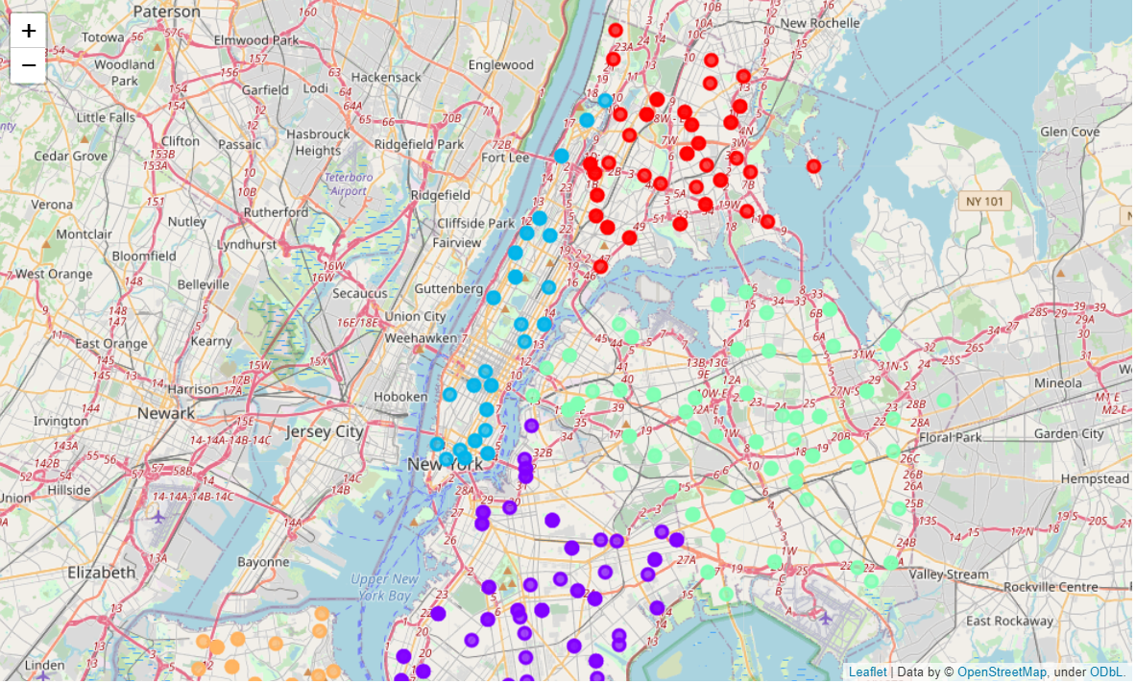
Key findings:
Manhattan density of Chinese restaurants is well spread for robust analysis of Chinese restaurants in the Manhattan area.
Notes:
Insert a picture of an animal and or plant found in your country.

Slide 8
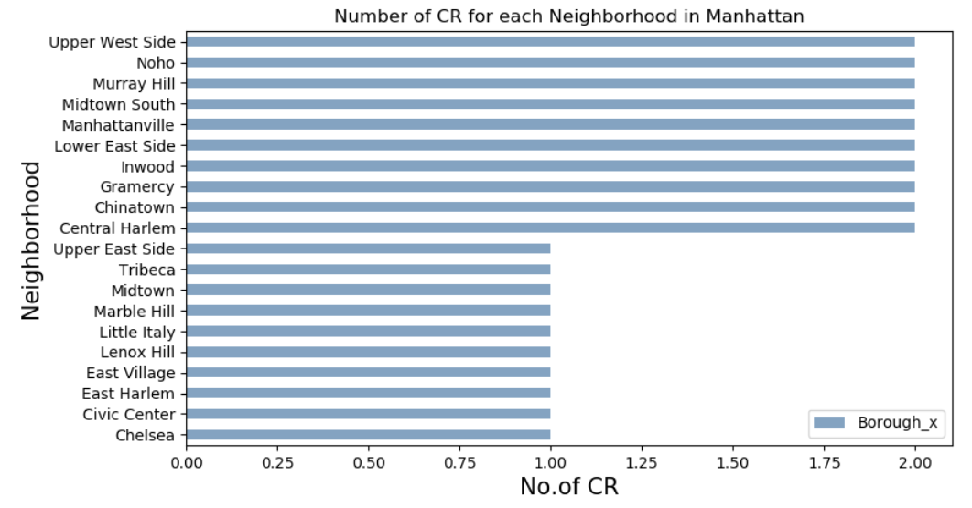
Key findings:
The best neighbourhoods for Chinese restaurants to open as proof of concept is shown in Manhattan as well as spread of Chinese restaurants across these neighbourhood’s allow for potential customer market steal.
Notes:
Insert a picture of an animal and or plant found in your country.

Slide 9
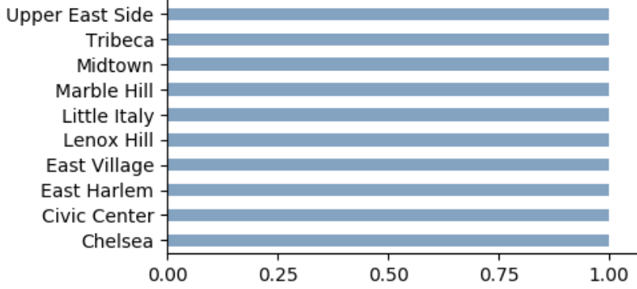
Conclusion:
Manhattan Borough has the best chance of making money when opening a Chinese restaurant.
Confirmed with the density of people per restaurant in the Manhattan area.
Chinese restaurants with the best rating are well spread and determination of the neighbourhood could be based on the neighbourhood Chinese restaurants count.
Any neighbourhood with Chinese restaurants less than 1 can be opportunity to open a restaurant.
Other criteria to take into account:
Costs of location
Logistics in these areas
Criminal rate of certain area
Notes:
Add key points in the history of your country to the timeline.

